Slide 1
Customer Churn Analysis
1
FACTORS TO CONSIDER
Ma. Angelica T. Mariano
From “Gizelle, Angel, Grace” Team

Slide 2

What is CHURN?
Rate at which customers stop doing business with an entity.
OUR COMPANY
PEERS

Slide 3
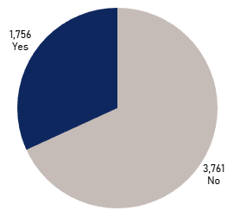
Churn Overview
of a Telecommunications Company
32%
of the customers
CHURN
~
~
Loss on Internet Sales:
Php 2,843, 273.95

Slide 4
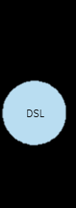
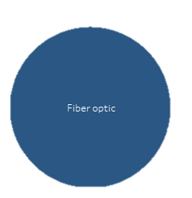

Factor 1: Internet Service
74% customers
who are most likely to churn are subscribed to
Fiber Optic Plan

Slide 5
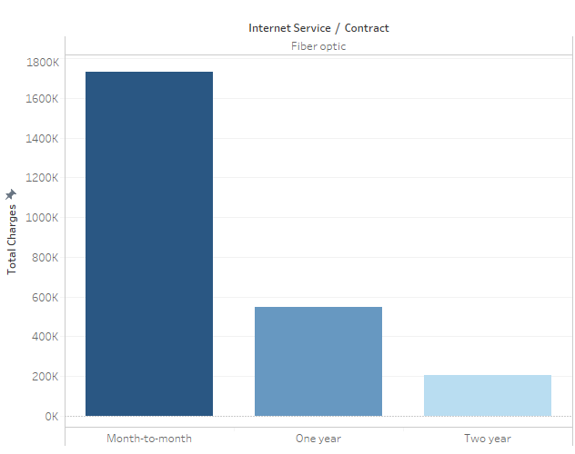


Factor 2: Contract
89% of the customers
who are most likely to churn
are on a Month-to-Month Contract

Slide 6
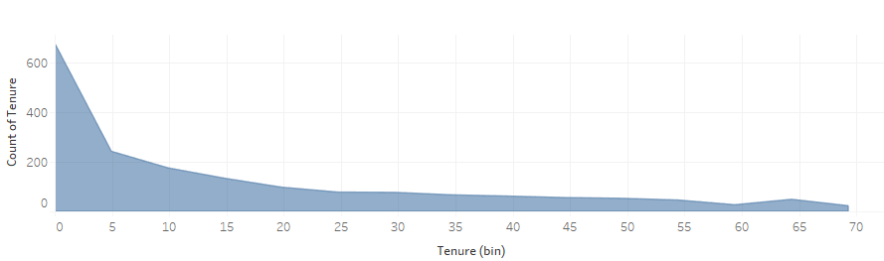

Factor 3: Tenure
82% of the customers who are
most likely to churn
have a tenure of 5 years and below

Slide 7
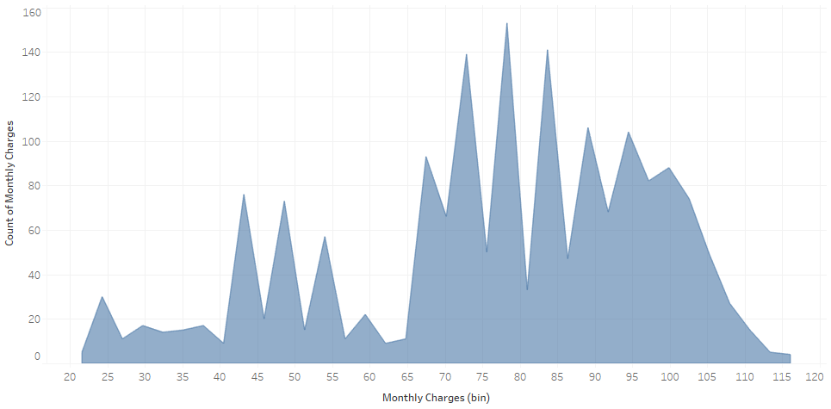

Factor 4: Monthly Charges
Customers who are being charged equivalent
to more than Php 60 per month are more likely to churn.

Slide 8
CUSTOMERS WHO ARE MOST LIKELY TO CHURN HAVE:
MONTH
-TO-
MONTH CONTRACTS
LESS THAN
5 YEARS
OF SUBSCRIPTION
HIGHER MONTHLY CHARGES
FIBER OPTIC INTERNET SERVICE

Slide 9
WHAT CAN WE DO ABOUT IT?
INCORPORATE A MINIMUM SUBSCRIPTION PERIOD FOR FIBER OPTIC INTERNET SERVICE
IMPLEMENT
LOYALTY AWARD / DISCOUNTS

Slide 10
BANG!
THANK YOU

